Slide 1
Tetris
Brian Cheung

Slide 2

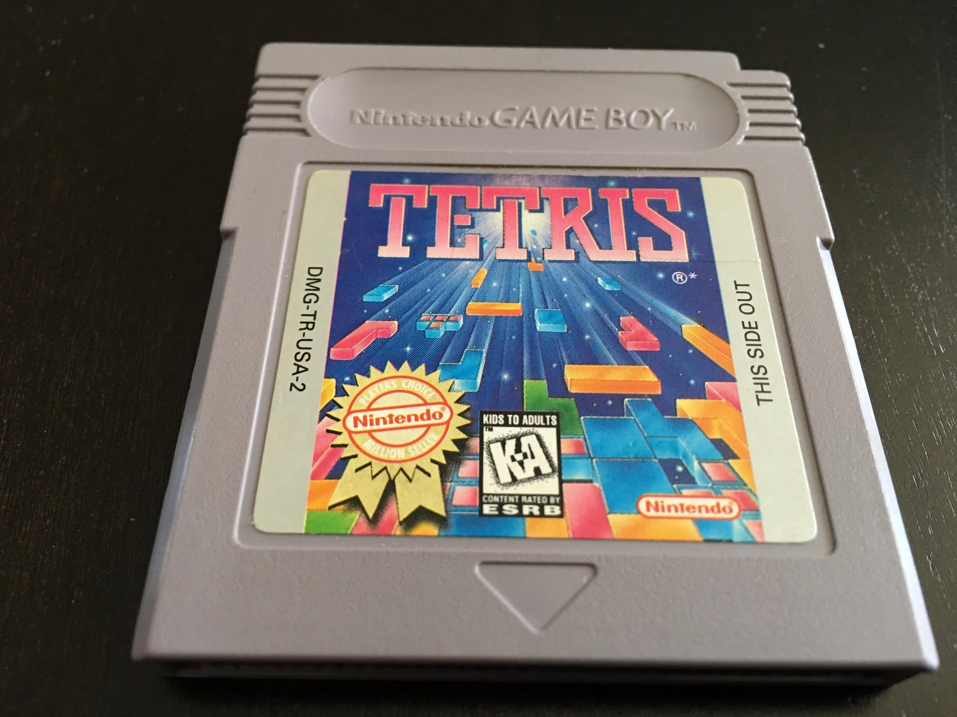



Brief History and Legacy
Alexey Pajitnov
Notes:
Created in 1984

Slide 3

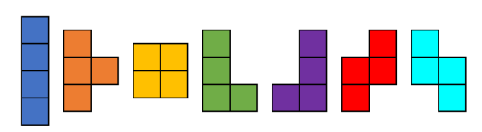
Mechanics of Tetris
Tetromino - a geometric shape composed of 4 squares

Slide 4
Computer Science Part!
Flood - sequence of the same piece
Drought - sequence omitting a certain piece
Tetris (1985) - Unbiased Randomizer
Tetris, Nintendo (1989) - 1 Piece History with 1 roll
Tetris: The Grand Master (1998) - 4 Piece History with 4 rolls
Tetris World and Onwards (2001) - 7 Piece Bag
Tetris: The Grand Master 3 (2005) - 35 Pool with 6 rolls
Notes:
Different versions of Tetris had different randomizers

Slide 5
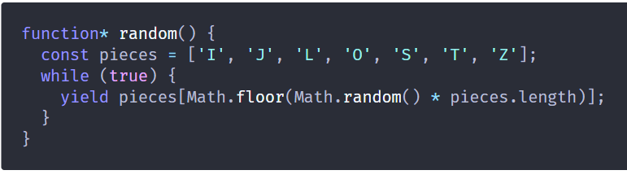
Unbiased Randomizer

Slide 6
Computer Science Part!
Flood - sequence of the same piece
Drought - sequence omitting a certain piece
Tetris (1985) - Unbiased Randomizer
Tetris, Nintendo (1989) - 1 Piece History with 1 roll
Tetris: The Grand Master (1998) - 4 Piece History with 4 rolls
Tetris World and Onwards (2001) - 7 Piece Bag
Tetris: The Grand Master 3 (2005) - 35 Pool with 6 rolls
Notes:
Different versions of Tetris had different randomizers

Slide 7
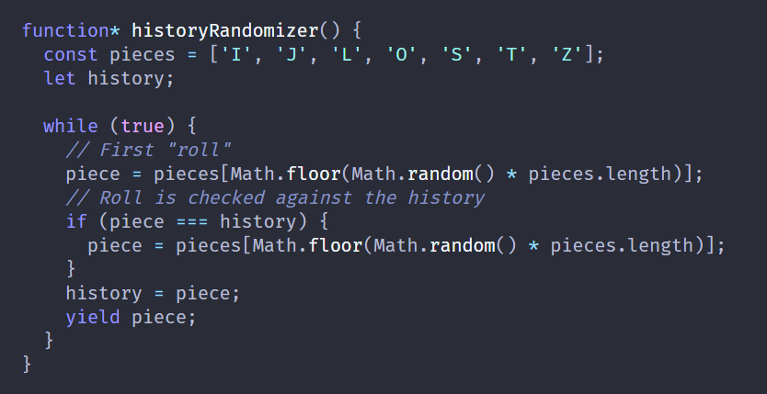
1 Piece History with 1 Roll

Slide 8
Computer Science Part!
Flood - sequence of the same piece
Drought - sequence omitting a certain piece
Tetris (1985) - Unbiased Randomizer
Tetris, Nintendo (1989) - 1 Piece History with 1 roll
Tetris: The Grand Master (1998) - 4 Piece History with 4 rolls
Tetris World and Onwards (2001) - 7 Piece Bag
Tetris: The Grand Master 3 (2005) - 35 Pool with 6 rolls
Notes:
Different versions of Tetris had different randomizers

Slide 9
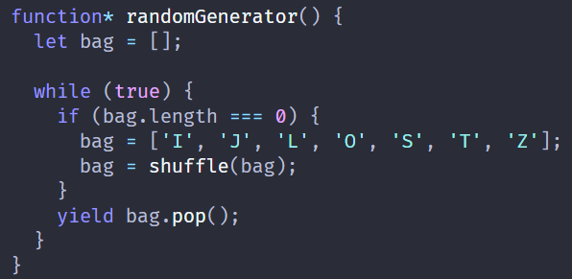
7 Bag

Slide 10
Computer Science Part!
Flood - sequence of the same piece
Drought - sequence omitting a certain piece
Tetris (1985) - Unbiased Randomizer
Tetris, Nintendo (1989) - 1 Piece History with 1 roll
Tetris: The Grand Master (1998) - 4 Piece History with 4 rolls
Tetris World and Onwards (2001) - 7 Piece Bag
Tetris: The Grand Master 3 (2005) - 35 Pool with 6 rolls
Notes:
Different versions of Tetris had different randomizers

Slide 11
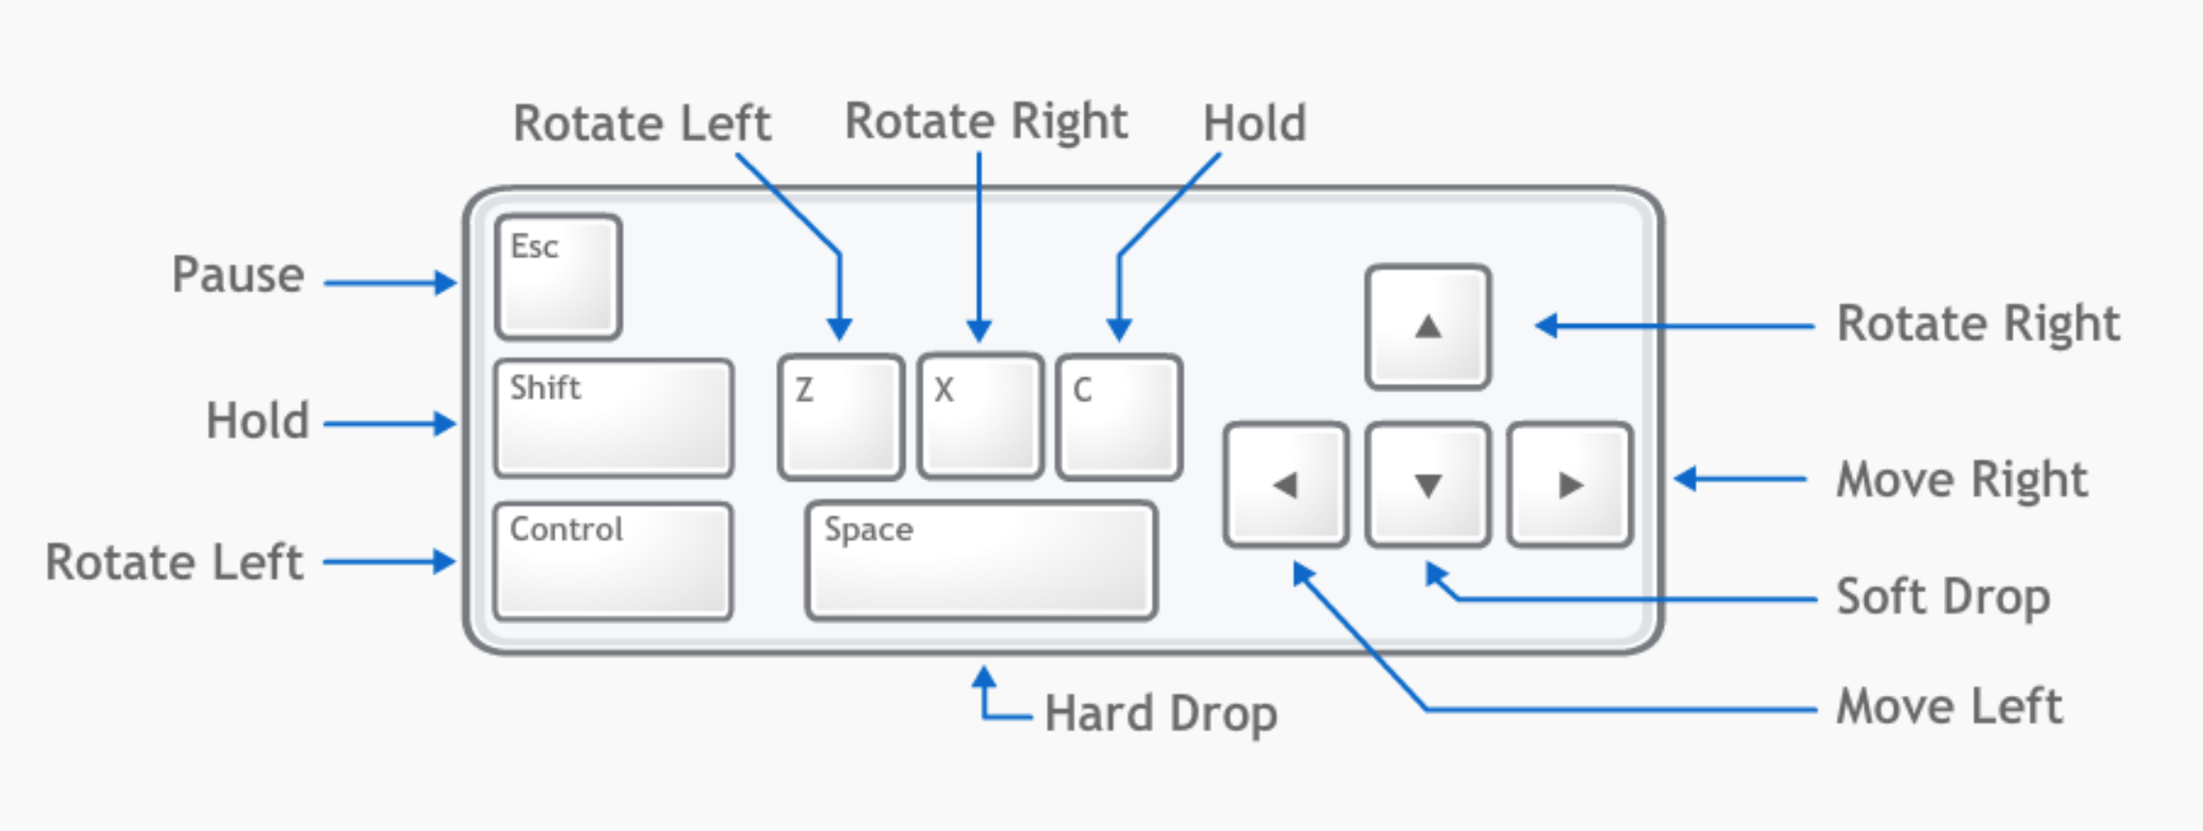
Controls

Slide 12
Fun
https://jstris.jezevec10.com/

